Slide 1


SAP S/4HANA Training
MASTER DATA GOVERNANCE (SAP MDG)
Neeraj Gupta
Session 13
SAP MDG – Process Modelling

Slide 2
Governance scope for a Data Model
13
SAP MDG – Process Modelling

Slide 3
Change Request Header
13
SAP MDG – Process Modelling

Slide 4
BADI: USMD_CREQUEST_INTEGRATION
13
SAP MDG - Process Modelling

Slide 5
Change request Status
11
SAP MDG – Process Modelling

Slide 6
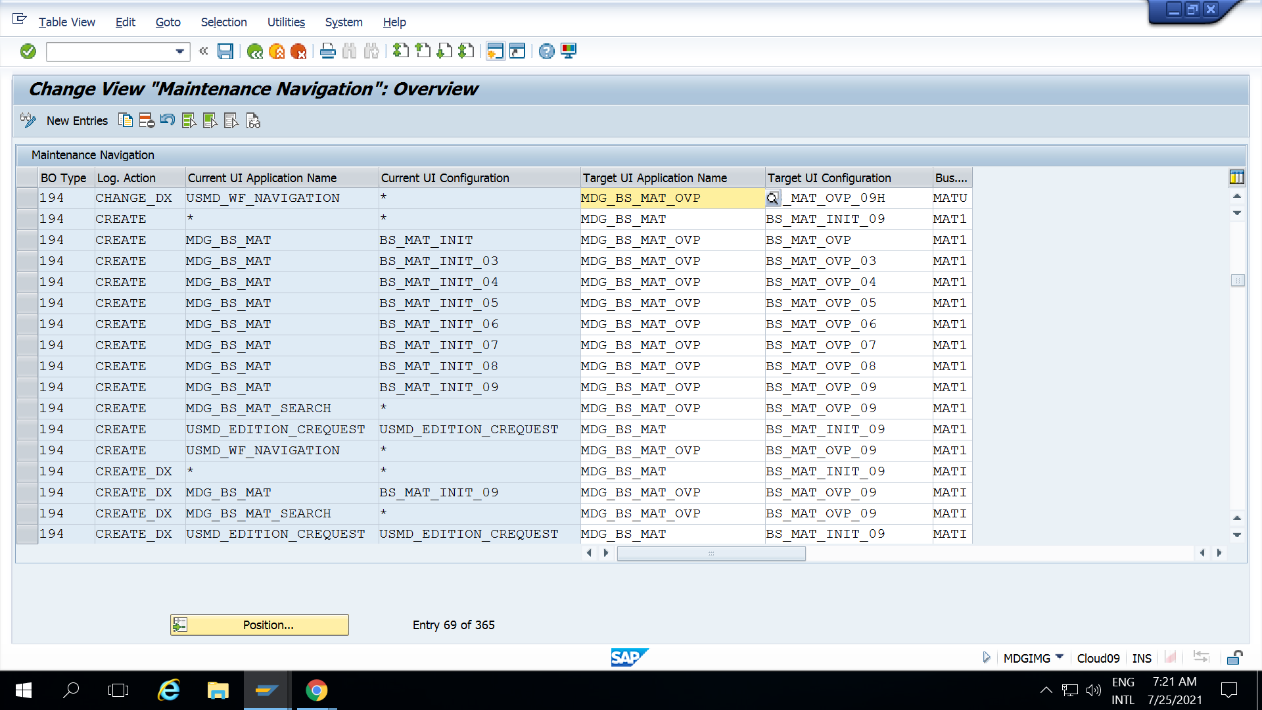
Link Logical Action with Business activity and UI Application
13
SAP MDG – Process Modelling

Slide 7
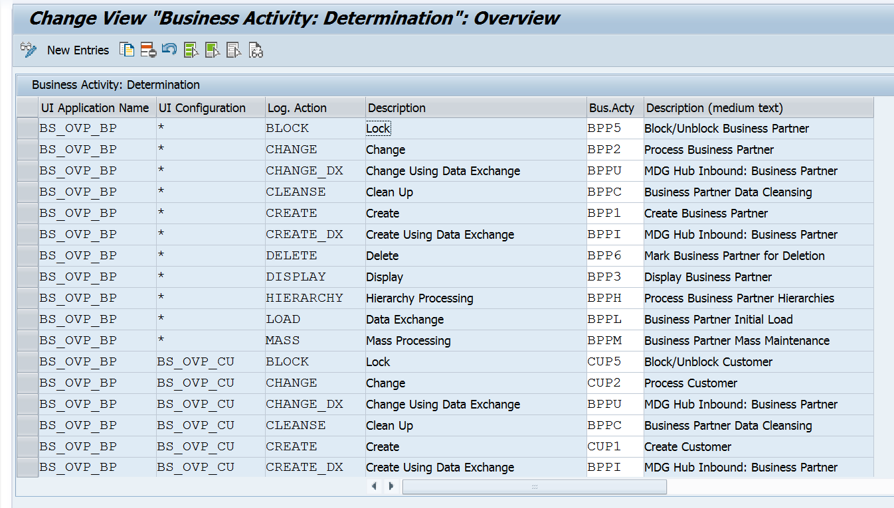
Link Each UI Application & Logical action with Business Activity
13
SAP MDG – Process Modelling

Slide 8
Parallel CR type: Scope of Entity
13
SAP MDG – Process Modelling

Slide 9
Example: SLA for a Change Request Type
13
SAP MDG – Process Modelling

Slide 10
Links between logical actions, business activity and change request types
13
SAP MDG – Process Modelling

Slide 11
Change request steps Other types of workflow template (Example: CUST1P2)
13
SAP MDG – Process Modelling

Slide 12
Enhancements and checks per change request step
13
SAP MDG – Process Modelling

Slide 13
Entity type properties for a change request step
13
SAP MDG – Process Modelling

Slide 14
Definition of change request actions
13
SAP MDG – Process Modelling

Slide 15
Step type and action assignment
13
SAP MDG – Process Modelling

Slide 16
Step types and actions
13
SAP MDG – Process Modelling

Slide 17
Decisions with Step Types
13
SAP MDG – Process Modelling

Slide 18
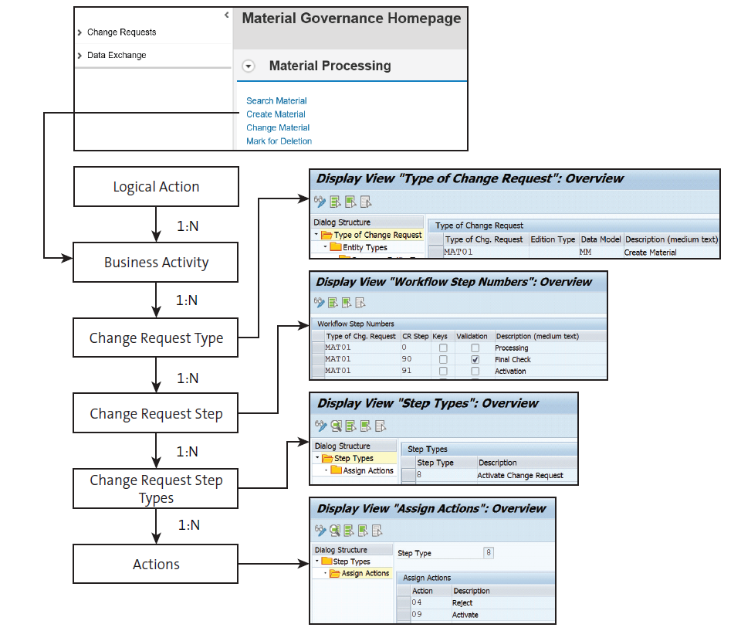
Change Request process step
13
SAP MDG – Process Modelling

Slide 19
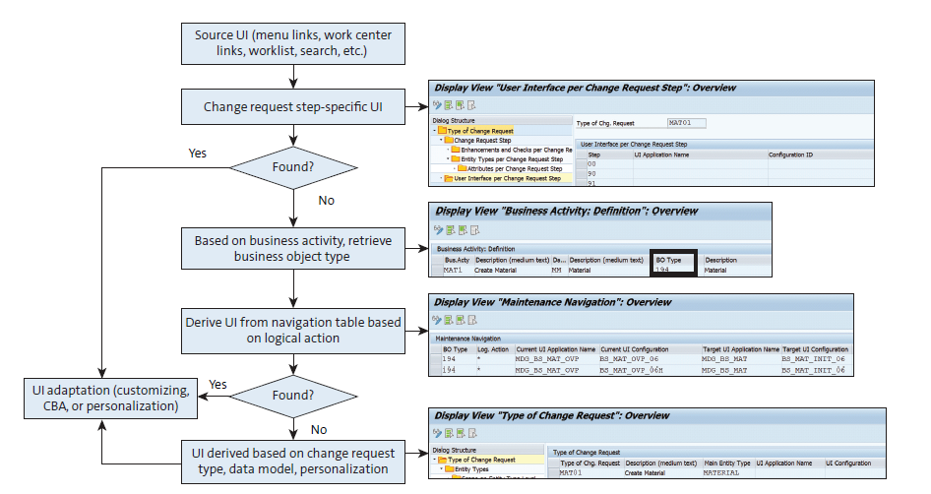
Change Request UI Determination
13
SAP MDG – Process Modelling

Slide 20

End of Session 13

Slide 21

Questions

Slide 22

Neeraj gupta

Slide 23


We’re committed to empower you to be
Most Desirable Resource
through powerful training solutions.
We build the workforce of the future.
250+
Corporate Clients
30,000+
Learners Trained
25000+
Learners Placed
FREE WEBINARS
Sign up for free webinars with industry experts every fortnight!
Enroll Now!
Contact us today!
https://anubhavtrainings.com/

Slide 24




More from AnubhavTrainings.com

